Slide 1
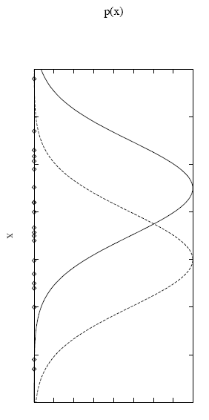
Model-based Clustering (1/17)
Model-based clustering assumes that …
The data were generated by an unknown model.
And tries to recover the original model from the data.
Then, the recovered model defines clusters and assigns documents to clusters.
For example, consider that the data D is a set of instances generated by a probability distribution that is a mixture of 2 distinct Normal distributions.
each instance is generated by first
selecting one of the Normal
distributions randomly
then x_{i} is generated according
to the selected distribution

Slide 2
Model-based Clustering (2/17)
For simplicity, we assume that …
The selection of the single Normal distribution is with uniform probability.
Each of the 2 Normal distributions has the same variance σ² and σ² is known.
The task is to find (recover) the model θ = <u₁,u₂> that describes the means of each of the two distributions.
And then use the model to calculate the Normal distribution (cluster label) that each instance belongs to.

Slide 3



Model-based Clustering (3/17)
Model recovery is a search problem:
In many cases, we will assume that the prior probability of every model is equal (e.g., P(θ_{i}) = P(θ_{j}) for all i and j in the model space).
Then…
$$θ=\underset{θ∈\text{model} \text{space}}{argmax}P(θ|D)$$
P(θ|D) is called the posterior probability of θ.
so, the maximal model in this form is called
a maximum a posteriori (MAP) model.
$$=\underset{θ∈\text{model} \text{space}}{argmax}\frac{P(D|θ)P(θ)}{P(D)} \\ =\underset{θ∈\text{model} \text{space}}{argmax}P(D|θ)P(θ)$$
$$θ=\underset{θ∈\text{model} \text{space}}{argmax}P(D|θ)$$
is often called the likelihood
of the data D given θ.
then … any model that maximizes P(D|θ)
is called a maximum likelihood model

Slide 4


Model-based Clustering (4/17)
Lets first consider a simple model search problem:
Assume that the instances <x₁, …, x_{N}> = D are generated by a single Normal distribution whose variance is σ².
And the distribution over models is uniform.
Thus, we are looking for a model θ = <u> that maximizes the likelihood P(D|θ):
Assuming the instances are mutually independent given θ, we can write P(D|θ) as the product of the various P(x_{i}|θ):
$$θ_{ML}=\operatorname{argmax}{P}(D|θ)$$
$$θ_{ML}={argmaxΠ}_{i=1}^{N}{P}(x_{i}|θ)$$

Slide 5
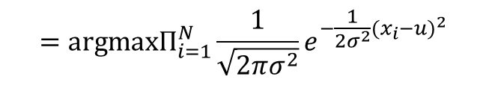

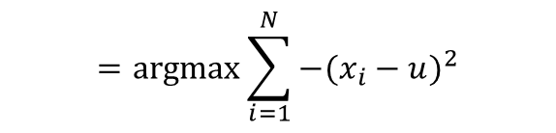
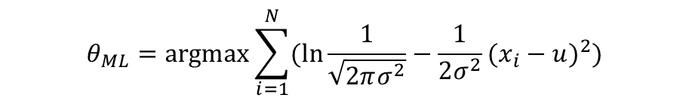
Model-based Clustering (5/17)
We can write the formula of Normal distribution to describe P(x_{i}|θ):
Now, we apply a transformation that is common in maximum likelihood calculation – logarithm.
$$θ_{ML}={argmaxΠ}_{i=1}^{N}{P}(x_{i}|θ)$$
$$={argmaxΠ}_{i=1}^{N}{\frac{1}{\sqrt{2πσ^{2}}}}e^{−\frac{1}{2σ^{2}}(x_{i}−u)^{2}}$$
$$θ_{ML}=\operatorname{argmax}{\sum_{i=1}^{N}{(\ln{\frac{1}{\sqrt{2πσ^{2}}}}−\frac{1}{2σ^{2}}(x_{i}−u)^{2})}}$$
$$=\operatorname{argmax}{\sum_{i=1}^{N}{−(x_{i}−u)^{2}}}$$

Slide 6




Model-based Clustering (6/17)
Maximizing this negative quantity is equivalent to minimizing the corresponding positive quantity:
To acquire u that minimizes the sum of the squared errors, we can
Then
or
$$θ_{ML}=\operatorname{argmax}{\sum_{i=1}^{N}{−(x_{i}−u)^{2}}} \\ =\operatorname{argmin}{\sum_{i=1}^{N}{(x_{i}−u)^{2}}}$$
$$\frac{∂\sum_{i=1}^{N}{(x_{i}−u)^{2}}}{∂u}=0$$
$$\sum_{i=1}^{N}{2(u−x_{i})}=0$$
$$u=\frac{1}{N}\sum_{i=1}^{N}{x_{i}}$$

Slide 7
Model-based Clustering (7/17)
The problem of the first mixture model (i.e., θ = <u₁,u₂>) is more complex since it involves a mixture of 2 different Normal distributions.
We cannot observe which instances were generated by which distribution.
and we cannot use the previous way to find θ_{ML}.
We can hope to find θ_{ML} using a very popular method – EM algorithm.
‘hope’ means that the solution obtained by EM may not be an optimal solution.
But the solution must be a local maximum likelihood model.

Slide 8
Model-based Clustering (8/17)
The EM algorithm is a widely used approach for learning in the presence of unobserved variables.
In this example, we can think of the full description of each instance as the triple <x_{i}, z_{i1}, z_{i2}>.
x_{i} is the observed value of the ith instance.
z_{i1} and z_{i2} are hidden (unobserved) variables
z_{ij} = 1 if x_{i} was created by the jth Normal distribution, and 0 otherwise.
The procedure of EM algorithm:
Beginning with a guess for θ.
Iterating the follow two steps until P(X|θ) converges to a local maximum.
Expectation step: calculate the expected value of each hidden variable, assuming the current model θ holds.
Maximization step: compute a new maximum likelihood model, given the expected value of each hidden variable.

Slide 9

Model-based Clustering (9/17)
For the mixture of 2 distinct Normal distributions problem
We first randomly initialize the parameters u₁ and u₂.
The E-step is to compute the expectation of hidden variable z_{ij} or E[z_{ij}].
So … E[z_{ij}] is just the probability that instance x_{i} was generated by the jth Normal distribution.
$$E[z_{ij}]=1∗P(z_{ij}=1|x_{i})+0∗P(z_{ij}=0|x_{i})=P(z_{ij}=1|x_{i})$$
$$E[z_{ij}]=\frac{P(u_{j})P(x_{i}|u_{j})}{P(x_{i})} \\ =\frac{1/2P(x_{i}|u_{j})}{\sum_{k=1}^{2}{1/2P(x_{i}|u_{k})}} \\ =\frac{e^{−\frac{1}{2σ^{2}}(x_{i}−u_{j})^{2}}}{\sum_{k=1}^{2}{e^{−\frac{1}{2σ^{2}}(x_{i}−u_{k})^{2}}}}$$

Slide 10

Model-based Clustering (10/17)
In the M-step, we use the E[z_{ij}] calculated during the E-step to derive a new maximum likelihood model θ’=<u’₁, u’₂>.
This equation is similar to the mean of the single Normal distribution problem.
It is the weighted mean for u_{j}, with each instance weighted by the expectation E[z_{ij}].
Each iteration increases the likelihood P(D|θ), unless it is at a local maximum [Mitchell 97].
$$u′_{j}=\frac{\sum_{i=1}^{N}{E[z_{ij}]x_{i}}}{\sum_{i=1}^{N}{E[z_{ij}]}}$$

Slide 11

Model-based Clustering (11/17)
Now, we applied the EM algorithm to document clustering.
Here, we assume that the data D is a set of documents generated by a probability distribution that is a mixture of K distinct multivariate Bernoulli distributions.
In a multivariate Bernoulli model …
Documents are represented as binary term incidence vectors.
The text generation process is viewed as a random process in which |V| independent Bernoulli trials are run.
$$P(d|ω)=\prod_{m=1}^{|V|}{(q_{m})^{I(t_{m},d)}(1−q_{m})^{(1−I(t_{m},d))}} \\ =\left(\prod_{t_{m}∈d}{q_{m}}\right)\left(\prod_{t_{m}∉d}{(1−q_{m})}\right)$$
I(t_{m},d) = 1 if t_{m} in d,
otherwise 0.
q_{m}: the probability that a document from model ω
contains term t_{m}.

Slide 12
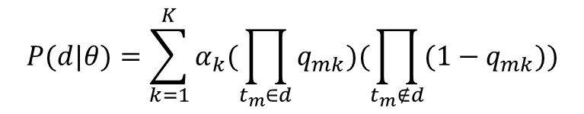
Model-based Clustering (12/17)
In a mixture of K distinct multivariate Bernoulli distributions …
The model parameters θ = {ω₁, ω₁, …, ω_{K}}.
ω_{k} = (q_{1k}, q_{2k}, … q_{Mk}, α_{k})
M = |V|.
q_{mk} is the probability that a document from model ω_{k} contains term t_{m}.
α_{k} is the prior probability of model ω_{k}.
And
$$P(d|θ)=\sum_{k=1}^{K}{α_{k}(\prod_{t_{m}∈d}{q_{mk}})(\prod_{t_{m}∉d}{(1−q_{mk})})}$$

Slide 13
Model-based Clustering (13/17)
How do we calculate the parameters α_{k} and q_{mk} from the data?
If we know which multivariate Bernoulli model generated which document … we can calculate α_{k} and q_{mk} by using Relative frequency.
E.g., α_{k} = (# of documents generated by Bernoulli model k) / N.
However, we cannot observe the information!!
Or … each document d_{i} has <z_{i1}, z_{i2},…, z_{iK}> hidden (unobserved) variables.
z_{ik} = 1 if d_{i} was created by the kth Bernoulli model, and 0 otherwise.
So we use EM algorithm to infer the parameters from the incomplete data.

Slide 14
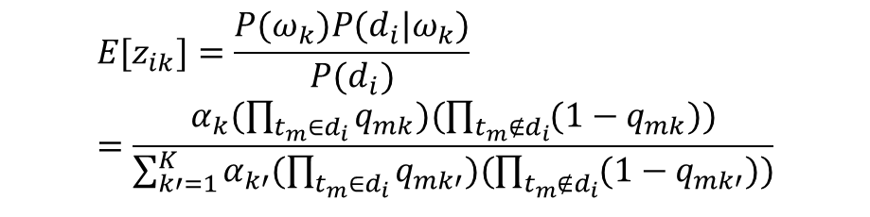
Model-based Clustering (14/17)
We can first randomly initialize the model parameters.
But need to follow the probability constraint: Σα_{k}=1 and 0≤α_{k}, q_{mk}≤1.
The expectation step:
Then
$$E[z_{ik}]=1∗P(z_{ik}=1|d_{i})+0∗P(z_{ik}=0|d_{i})=P(z_{ik}=1|d_{i})$$
$$E[z_{ik}]=\frac{P(ω_{k})P(d_{i}|ω_{k})}{P(d_{i})}=\frac{α_{k}(\prod_{t_{m}∈d_{i}}{q_{mk}})(\prod_{t_{m}∉d_{i}}{(1−q_{mk})})}{\sum_{k′=1}^{K}{α_{k′}(\prod_{t_{m}∈d_{i}}{q_{mk′}})(\prod_{t_{m}∉d_{i}}{(1−q_{mk′})})}}$$

Slide 15


Model-based Clustering (15/17)
The maximization step:
These are MLEs for parameters except that documents are assigned fractionally to cluster here.
$$q_{mk}=\frac{\sum_{i=1}^{N}{E[z_{ik}]I(t_{m},d_{i})}}{\sum_{i=1}^{N}{E[z_{ik}]}}$$
$$α_{k}=\frac{\sum_{i=1}^{N}{E[z_{ik}]}}{N}$$
and

Slide 16
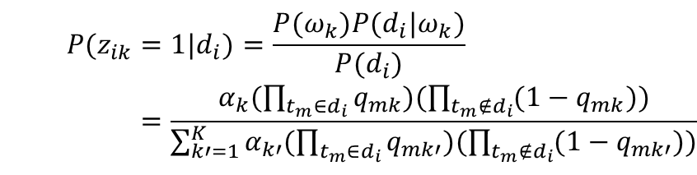
Model-based Clustering (16/17)
When we reach local maximum, the parameters α_{k} and q_{mk} can perform soft clustering.
Basically, this soft clustering is identical to E[z_{ik}] computed in the final iteration.
$$P(z_{ik}=1|d_{i})=\frac{P(ω_{k})P(d_{i}|ω_{k})}{P(d_{i})} \\ =\frac{α_{k}(\prod_{t_{m}∈d_{i}}{q_{mk}})(\prod_{t_{m}∉d_{i}}{(1−q_{mk})})}{\sum_{k′=1}^{K}{α_{k′}(\prod_{t_{m}∈d_{i}}{q_{mk′}})(\prod_{t_{m}∉d_{i}}{(1−q_{mk′})})}}$$

Slide 17
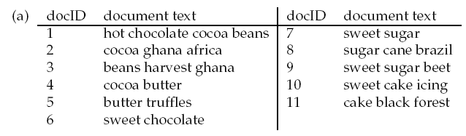
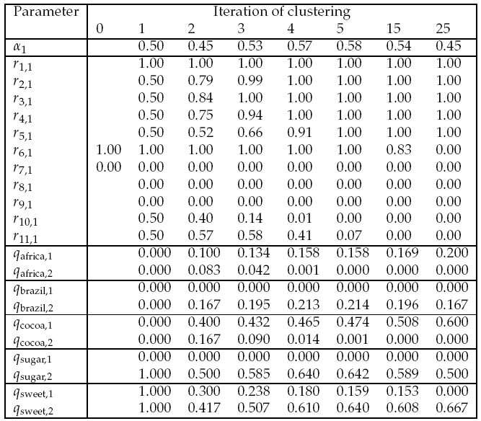
Model-based Clustering (17/17)
E[z_{1,1}]
E[z_{2,1}]
E[z_{3,1}]
E[z_{4,1}]
E[z_{5,1}]
E[z_{6,1}]
E[z_{7,1}]
E[z_{8,1}]
E[z_{9,1}]
E[z_{10,1}]
E[z_{11,1}]
K=2, initially assign document 6 to
cluster 1 and document 7 to cluster 2.
while the final assignment is a hard
clustering here, EM usually converges
to a soft assignment.

